Slide 1
Stock Market Analysis
Team 1
Mentor: Rajashekhar
24/02/2023

Slide 2
Business Problem:
Objective:
Predict the Reliance Industries Stock Price for the next 30 days.
There are Open, High, Low and Close prices that you need to obtain from the web for each day starting from 2015 to 2022 for Reliance Industries stock.
Split the last year into a test set- to build a model to predict stock price.
Find short term, & long term trends.
Understand how it is impacted from external factors or any big external events.
Forecast for next 30 days.

Slide 3
Project Flow
Data Scrapping
Data pre processing
EDA
Data splitting
Model Building

Slide 4
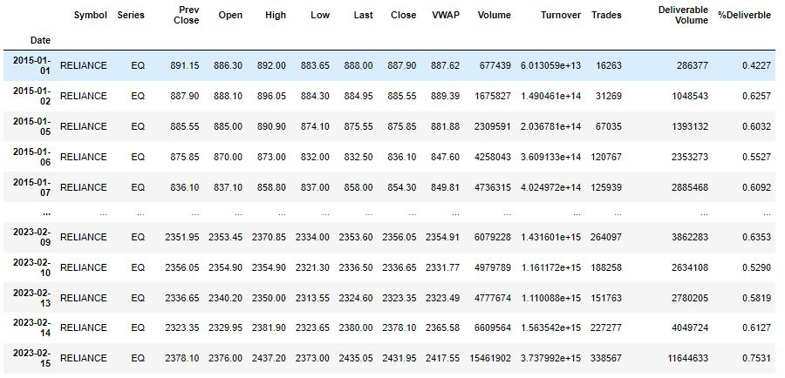
Data Scrapping
Data scrapping was done by nsepy library.

Slide 5
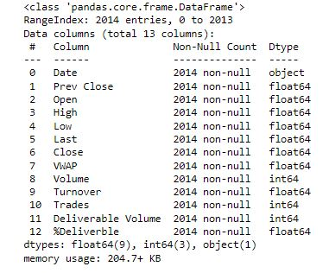
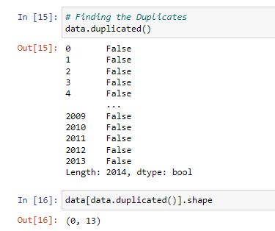
Details of the dataset
there are 2014 rows of data available and for each row, we have 13 different features or columns.
there are no null values in the data set.
There are no duplicates values.

Slide 6
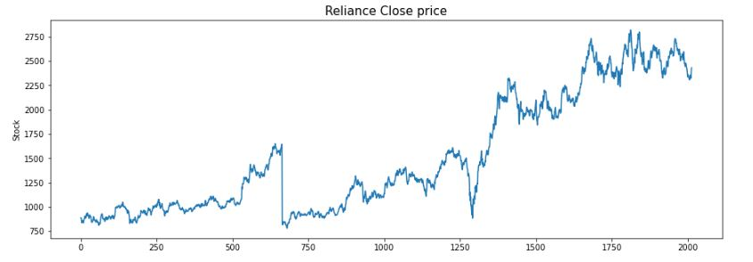
Exploratory Data Analysis (EDA)
The prices of Reliance stocks are showing an upward trend as depicted by the plot of the closing price of the stocks.

Slide 7
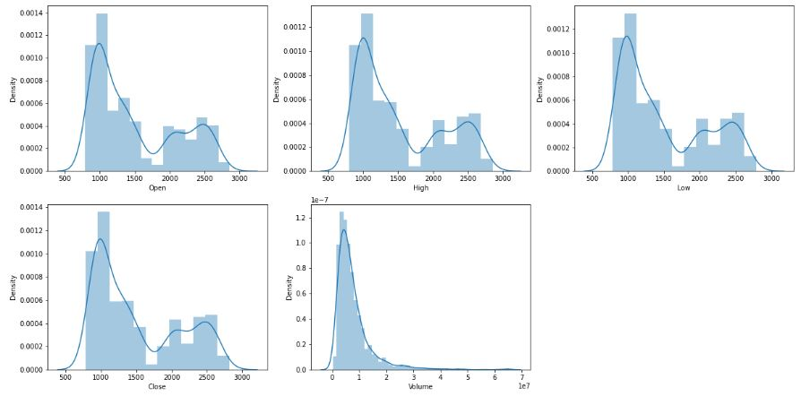
Continue…
There are two peaks which means the data has varied significantly in two regions, and the Volume data is left-skewed.

Slide 8
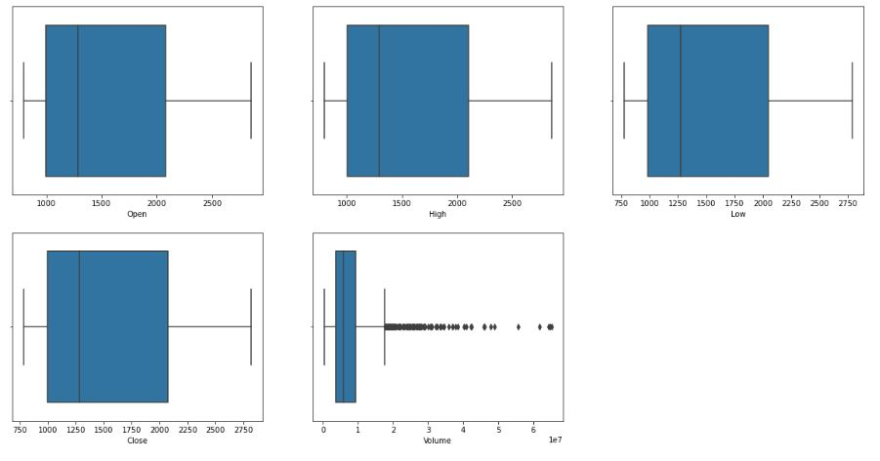
Continue…
From the given boxplot, we can conclude that only volume data contains outliers in it but the data in the rest of the columns are free from any outlier.

Slide 9
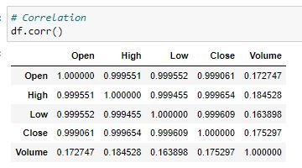
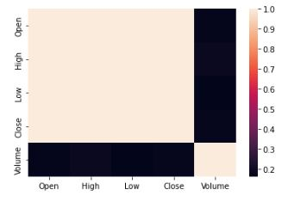
Continue
From this we can say that Open
Price, Close price, highest point of
the stock price and lowest point of
the stock price are highly
correlative.

Slide 10
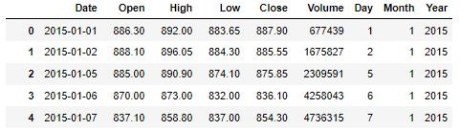
Feature Engineering
Feature Engineering helps to derive some valuable features from the existing ones.
These extra features sometimes help in increasing the performance of the model significantly and certainly help to gain deeper insights into the data.
Now we have three more columns namely ‘day’, ‘month’ and ‘year’ all these three have been derived from the ‘Date’ column which was initially provided in the data.

Slide 11
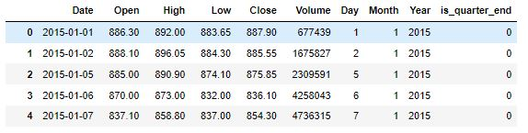
Continue…
A quarter is defined as a group of three months. Every company prepares its quarterly results and publishes them publicly so, that people can analyze the company’s performance.
These quarterly results affect the stock prices heavily which is why we have added this feature because this can be a helpful feature for the learning model.

Slide 12
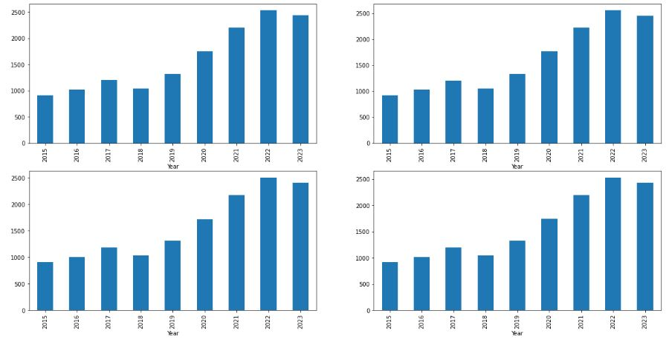
Continue…
From the above bar graph, we can conclude that the stock prices have doubled from the year 2018 to that in 2021.

Slide 13
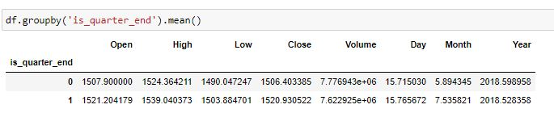
Continue…
From this we can say that Prices are higher in the months which are quarter end as compared to that of the non-quarter end months.

Slide 14
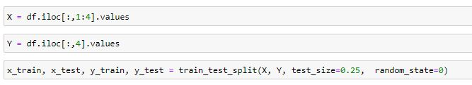
Data Splitting and Normalization
For data splitting X is holding values for the open, high and low column and Y is holding values of the close price column.
Whole data has been split into two parts with a 75:25 ratio so, that we can evaluate the performance of our model on unseen data.

Slide 15
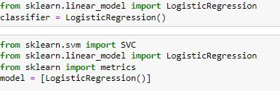
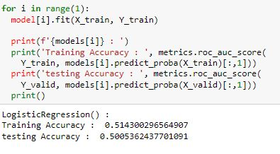
Model Building
1. Logistic regression model
For the evaluation metric, we are using the ROC-AUC score
The accuracy of training data is 51.43 %
The accuracy of testing data is 50.05%

Slide 16
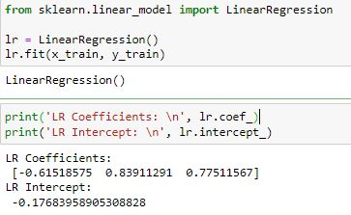
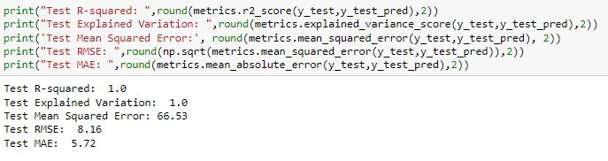
Continue…
2. Linear regression model
The R-squared of test data is 1
Mean squared error is 66.53
Root Mean squared error id 8.16
Mean absolute error is 5.72

Slide 17
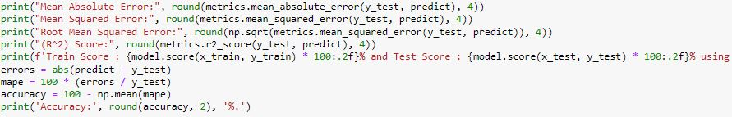
Continue…
3. Random Forest Regression model
Mean absolute error is 8.84
Mean squared error is 170.28
Root mean squared error is 13.04
And R-squared is 0.993

Slide 18
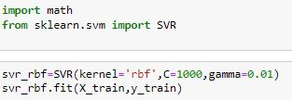
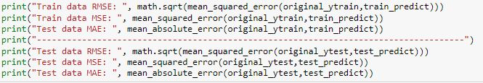

Continue…
Super Vector Regression model
RMSE, MSE and MAE of test data is 52.59,68.15 and 66.860 respectively.
R squared score of train and test data is 0.99 and 0.77 respectively.

Slide 19
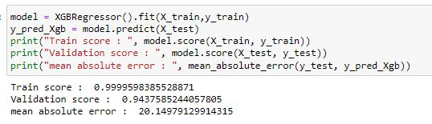
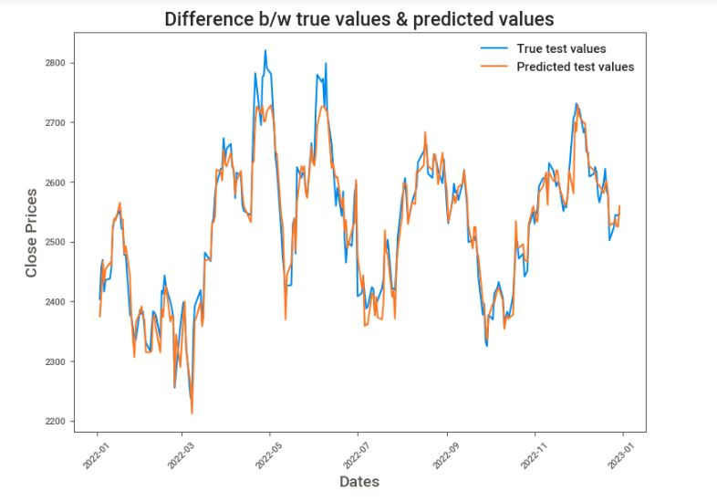
Continue…
5. Extreme Gradient Boosting (XGB)

Slide 20
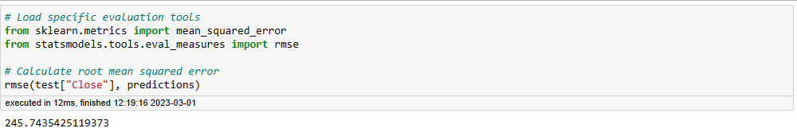
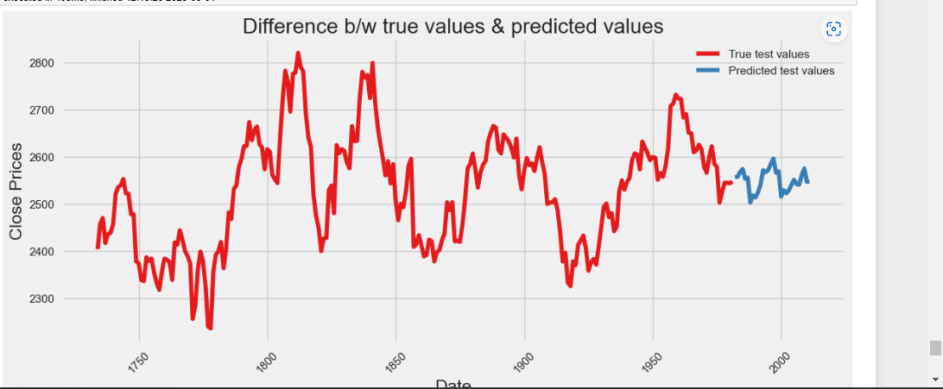
Continue..
6. Sarimax

Slide 21
Deployment:
Deployment of Reliance_stock has done by Prophet library.
Prophet is a open source library, developed by Facebook to forecast time_series data.

Slide 22
Forecasting of next 30days of Reliance stock :

Slide 23
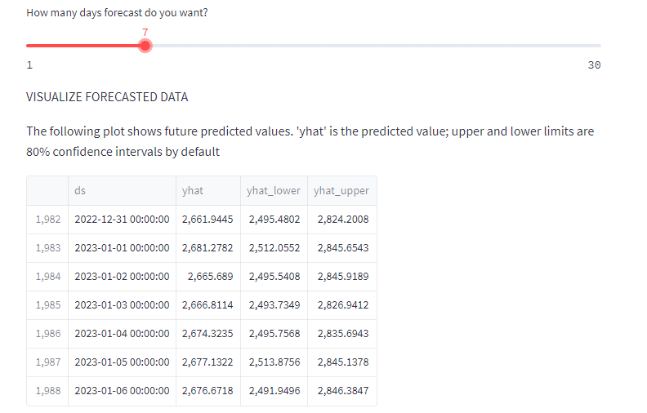
Slider shows the no. of days predicted close of Reliance stock.
Here, I selected the next 7days forecasting (Reliance).
ds is the Date, yhat is Predicted closing price, yhat_lower is predicted lowest price on that day and yhat_upper is the predicted highest price on that day.

